Slide 1
CU6051 Artificial Intelligence Project: Garden Robot
Name: Chiemela Ndukwe & Isaac Furieri
VIVA Presentation

Slide 2
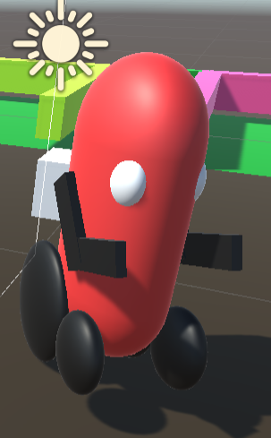
Agent Task - Crop detection and harvesting
Performance 1
How Does Agent Measure performance? Safety
Crop not surrounded by weeds, crop not surrounded by flood, pests not close to the crop, soil colour not black. If the crop does not have these prior conditions, then the agent will know the crops are safe. The agent will run this routine check every 6 hours. If the agent learns that one of these things are happening to the crop, then it will act accordingly to save the crop by making sure the identified threat is neutralized.
Agent

Slide 3
Agent Task - Crop detection and harvesting
Performance 2
How Does Agent Measure performance? Maximize harvest
If the soil sample taken from the farm contains more than 50% nitrogen (N), phosphorus (P) and potassium (K) which make up the trio known as NPK, then the agent will know that farm yield will be at a maximum. If the soil sample does not meet this base requirement, then it will add more fertilizers to the soil depending on the quantity that is required and will repeat this routine the next day. If the analysis shows that the required nutrient stated above are more than 50% then the agent will do nothing more to improve and check the soil.
Agent

Slide 4
Agent Task - Crop detection and harvesting
Performance 3
How Does Agent Measure performance? Accuracy
Recognize the ripe fruit by using the UAV-Based RGB Imagery for Hokkaido Pumpkin (Cucurbita max.) Detection and Yield Estimation (Lucas Wittstruck, Insa Kühling, Dieter Trautz, Maik Kohlbrecher, Thomas Jarmer, 2020).
Go horizontally underneath the pumpkin by measuring the distance left and right distance of the pumpkin from the centre of the harvester by using Ultrasonic Sensors (Roderick Burnett, 2020). This is to make sure the pumpkin falls right in the middle of the harvester.
Cut the stem attached to the fruit using the blade attached to its robotic arm grabbers to clip the stem.
Agent

Slide 5
Agent Task - Crop detection and harvesting
Performance 4
How Does Agent Measure performance? Harvesting success rate
Perform all the tasks in the Accuracy section until their isn’t any ripe fruit left on all the trees.
Successfully transport the fruits to the store without any fruit falling from the harvester.
Gently tilts the harvester vertically so that all the pumpkin will roll out and then tilt the harvester back to the horizontal position.
Use the UAV-Based RGB Imagery for Hokkaido Pumpkin (Cucurbita max.) Detection and Yield Estimation (Lucas Wittstruck, Insa Kühling, Dieter Trautz, Maik Kohlbrecher, Thomas Jarmer, 2020) system to see if it recognizes any pumpkin that might still be in the harvester and if it recognizes a pumpkin, then it will gently tilt the harvester again but this time before it reaches 90° angle, it will use force to jerk the fruit to make it fall.
Agent

Slide 6
Agent Task - Crop detection and harvesting
Performance 5
How Does Agent Measure performance? System Diagnosis
The agent will run a system diagnosis before it checks for the safety of the crops which is every 6 hours, agent will run a system diagnosis before it attempts to maximize harvest, agent will run a system diagnosis before it attempts to harvest the crops, agent will run a system diagnosis before it attempts to offloads the harvested crops, agent will run a system diagnosis after it offloads all pumpkin from the harvester. This diagnosis will check the mobility of the agent, the robotic arm movement, the sensors, the software programs, the inbuilt components. In the case whereby the agent is not able to repair itself or runs out of battery in the middle of the field, then the manual override will be activated by the farmer which will allow the farmer to push the agent to where he can change the battery or replace broken parts.
Agent

Slide 7
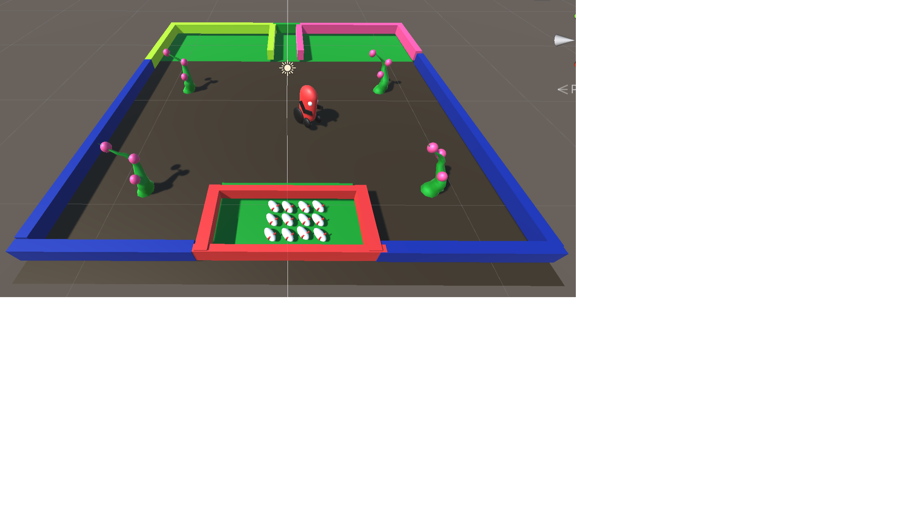
Agent Task - Crop detection and harvesting
Environment
The agent’s environment shall always be the farm. The farm walls which will surround the farm. The GPS will be mounted round the farm to let the agent know the walls are not walkable. The agent shall also use this GPS as waypoints to know where the pumpkin trees are. The store/harvest area is where agent will store harvested fruits. The solution area is where the agent will take soil samples to and also where it will go to recharge it battery.
Farm

Slide 8
Agent Task - Crop detection and harvesting
Actuators 1
A specifically developed robotic arm for this application.
A developed end-effector for pumpkin.
A controlling system for the robotic arm.
Bluetooth device and WiFi connection to the network.
Balancing systems such as standard farming tyres and wheels as specified by the European Tyre and Rim Technical Organisation (ETRTO). These balancing machines are suitable for balancing the automotive components that need high precision, low noise and a vibration reduction in order to guarantee a safer performance.
Agent

Slide 9
Agent Task - Crop detection and harvesting
Actuators 2
How will the agent be able to check the crop?
digging its robotic arm about 6 inches below its tyre horizontal level (Fine Gardening, 2021),
curl its robotic end-effector to a 90° angle to scoop up some soil sample,
use the GPS to get the fastest root to the laboratory where the atomic absorption spectrophotometer is located and finds its way using waypoints,
turns its end-effector at 180° and vibrates the end-effector for 30 seconds to make sure the scooped soil is emptied in the atomic absorption spectrophotometer (Fine Gardening, 2021)
Agent

Slide 10
Agent Task - Crop detection and harvesting
Actuators 3
How will the agent be able to check the crop?
the agent will connect to the spectrophotometer using Bluetooth and will send a signal to turn on the spectrophotometer (Note: this analysis usually takes few weeks (Fine Gardening, 2021) telling you major and minor nutrients, pH. Once the analysis are complete the agent will receive the results over the WiFi) then the agent will go back to the pumpkin tree using the GPS waypoint round each tree,
the agent will use its end-effector to determine how hollow it is,
the agent shall use UAV-Based RGB Imagery for Hokkaido Pumpkin (Cucurbita max.) to determine the colour of the pumpkin fruit and stem
Agent

Slide 11
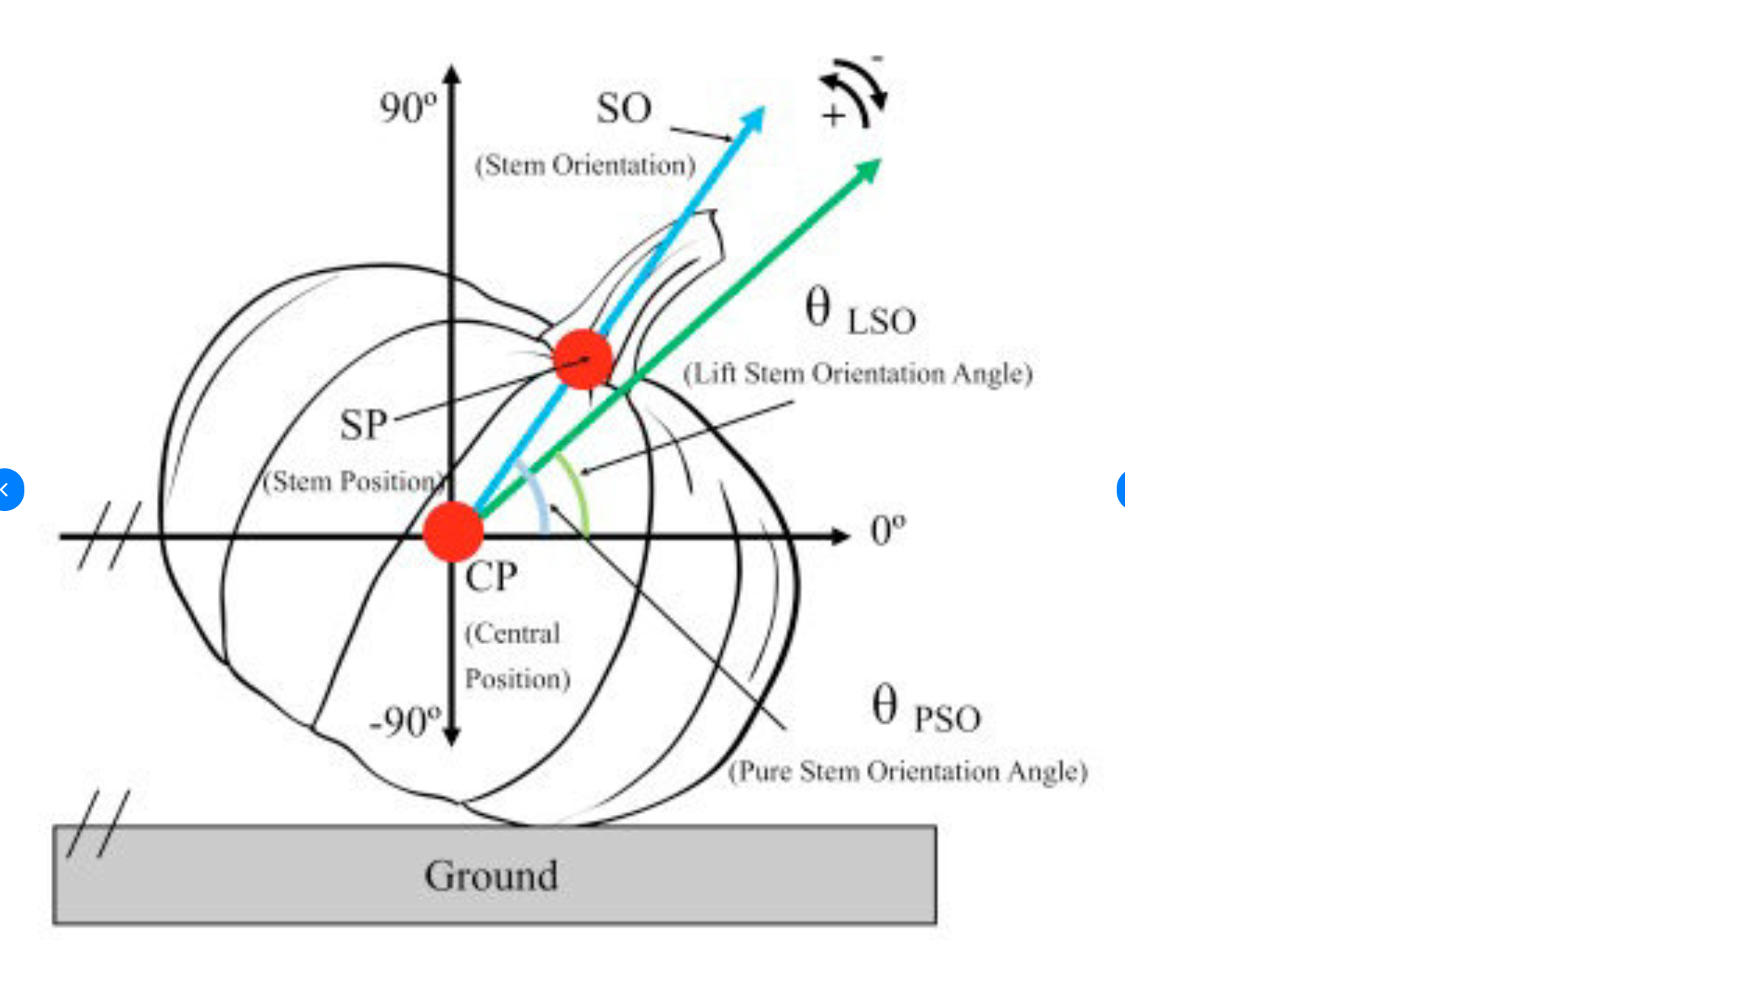
Agent Task - Crop detection and harvesting
Actuators 4
How will the agent be able to check the crop?
the agent will use the WiFi to connect to the database and log the condition of the farm terrain, upload its locomotion statistics, upload the results from the soil analysis, upload how hollow the fruit is, upload the colour of the pumpkin fruit and stem,
agent will perform calculations on the uploaded data and will draw conclusion based on the data to wither pick out the bad fruit with the robotic arm or to leave it.

Slide 12
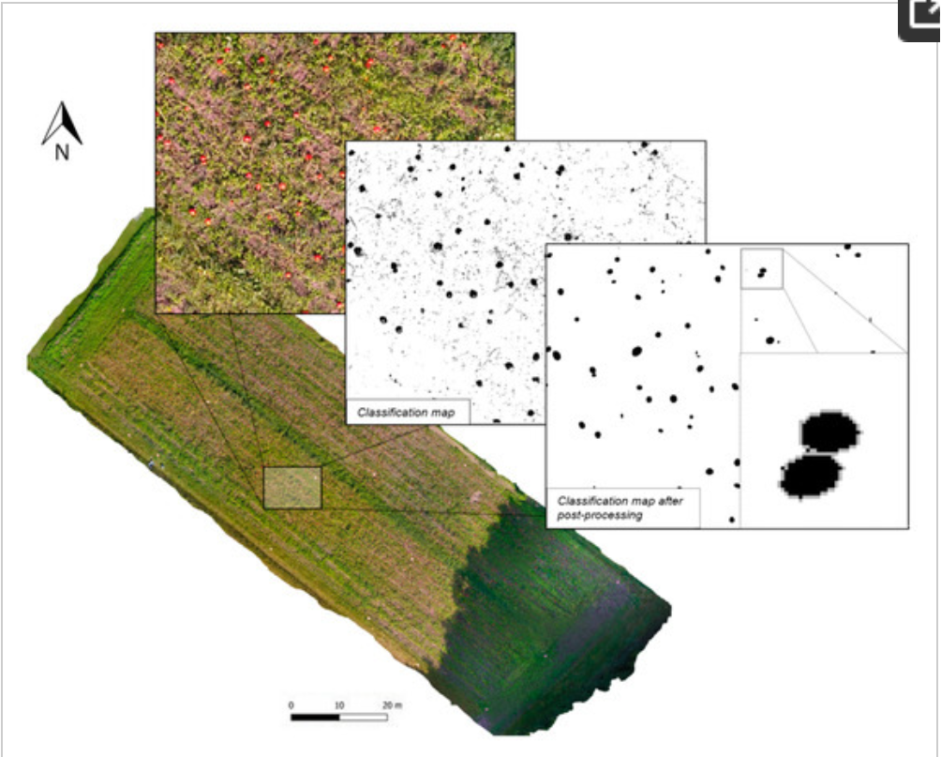
Agent Task - Crop detection and harvesting
Sensors 1
What sensors will the agent have?
The agent shall have UAV-Based RGB Imagery for Hokkaido Pumpkin (Cucurbita max.) Detection and Yield Estimation (Lucas Wittstruck, Insa Kühling, Dieter Trautz, Maik Kohlbrecher, Thomas Jarmer, 2020) for fruit detection, colour detection, stem detection.
The agent shall have Bluetooth device.
The agent shall have WiFi to connect to the network.
The agent shall have GPS to know where the trees are, where the store is, where the laboratory is.
UAV-Based RGB Imagery for Hokkaido Pumpkin
Orthophoto with selected classification steps during fruit detection procedure.

Slide 13
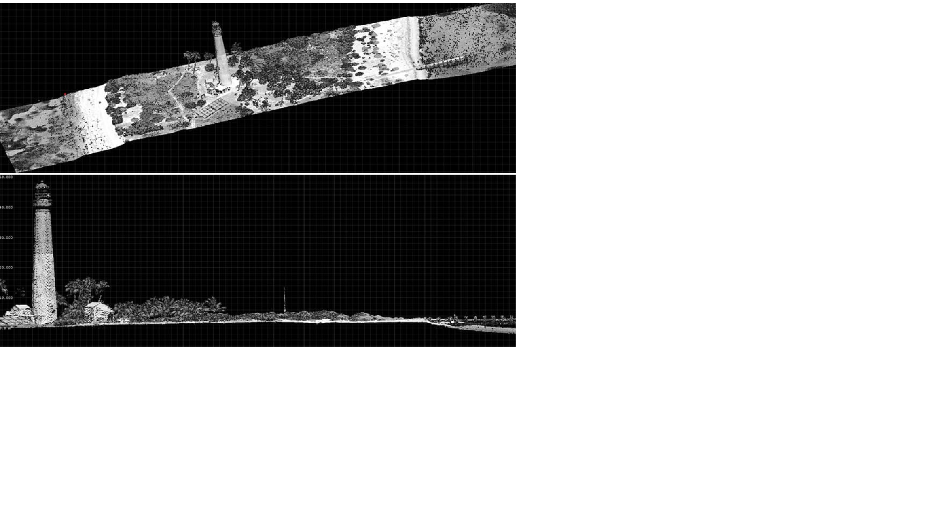
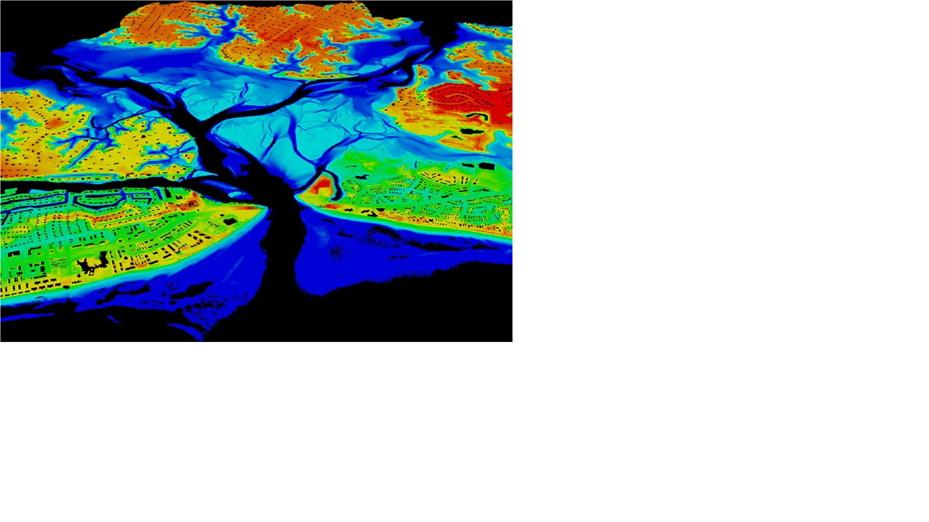
Agent Task - Crop detection and harvesting
Sensors 2
What sensors will the agent have?
The agent shall have Ultrasonic Sensors (Roderick Burnett, 2020). This will enable it know the position of the fruit and the harvester so that the fruit fall perfectly into the harvester when it’s harvesting the fruit.
The agent shall have a date and time installed. This will enable it know when to start its daily cycle.
The agent shall have thermometer installed to be able to tell the weather.
The agent shall have Lidar installed. Lidar — Light Detection and Ranging — is a remote sensing method used to examine the surface of the Earth (National Oceanic and Atmospheric Administration, 2023). The agent shall use this sensor to understand the terrain and the earth’s surface to know how to navigate itself.
Lidar

Slide 14
Agent Task - Crop detection and harvesting
Reflections / challenges identified
The biggest challenge for this agent is the weather because the flood will make the soil slippery which means it will use more power during this time to force itself while making drainage channel the flood out of the farm.
The crop analysis is limited to only checking the soil, the stem and fruit colour, and how hollow the fruit is.
There isn’t further checks such as the mass of the fruit while it is still attached to the stem or how soft the flesh of the fruit are because doing these the agent might crush the fruit.
When the weather gets bad, there could be loss of connection between the control room and the agent in the field which means the agent will not be able to harvest the crops because it does not know where the crops are because it uses GPS to locate them, the agent will not know where the store house and laboratory are because it also uses GPS to locate them.
Taking a soil sample during the winter season is challenging because the soil becomes hard and frozen which will make it difficult for the agent to perform the soil analysis.

Slide 15
End of Presentation
The demo will be done in Unity

